Slide 1

On Detecting New Worlds:
The Art of Precise Doppler Spectroscopy
Using Iodine Cells
Sharon Xuesong Wang
Thesis Advisor: Jason T. Wright
Thesis Defense, May 31, 2016
Notes:
Thanks for having me. It’s my great pleasure today to share with you a piece of my journey diving into precise radial velocity data.

Slide 2
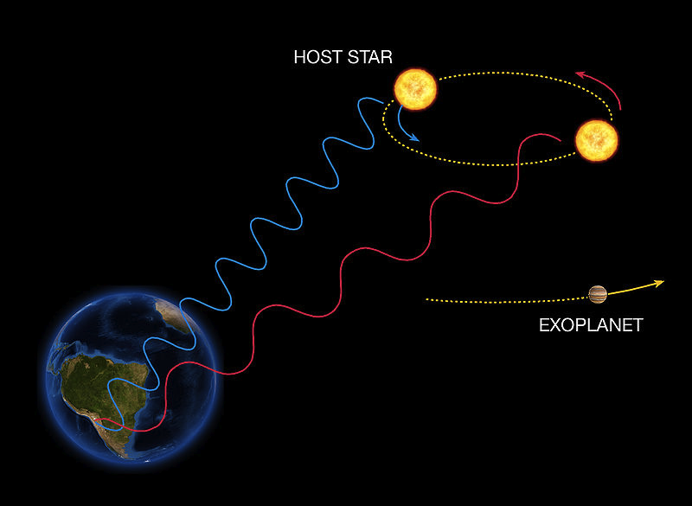
Radial Velocity (RV)
measured by precise Doppler spectroscopy
image credit: ESO
Notes:
So how do you measure the mass of an exoplanet. Well currently the most productive method in doing this is the radial velocity method, where you measure the doppler shift of the star’s spectra due to the gravitational pull of the planet. Most of the exoplanet masses are measured using radial velocities. This is really the workhorse for the task.

Slide 3
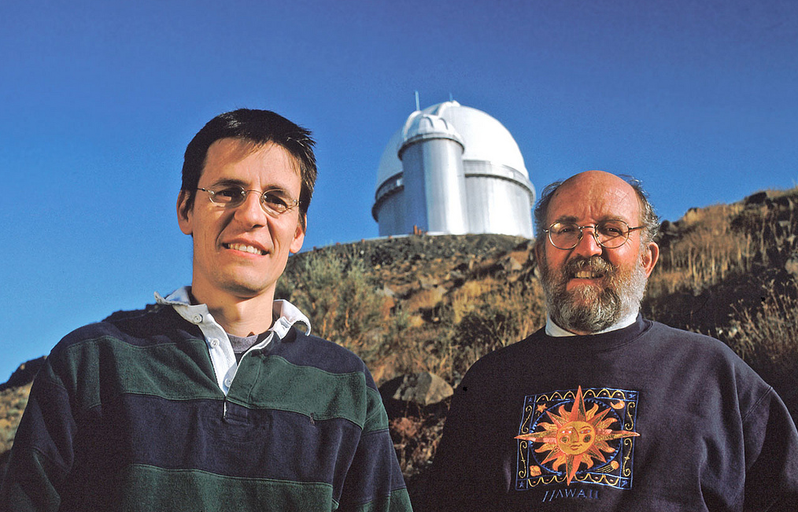
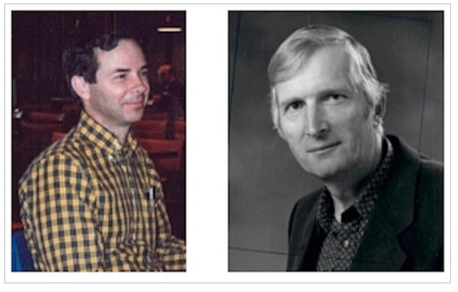
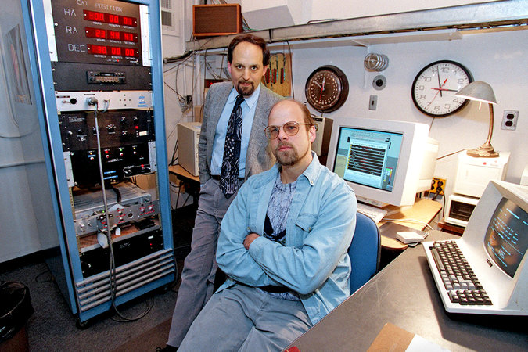
first discoveries of exoplanets
1955 Otto Struve, first documented concept
1973 Griffin & Griffin, proposed 10 m/s
1988 Campbell & Walker et al., 15 m/s
1989 Latham et al., 100 m/s
1993 Hatzes & Cochran, 20 m/s
1993 Wolszczan & Frail, first exoplanet
1995 Mayor & Queloz, 15 Peg b
1996 Marcy & Butler, the next 9 exoplanets
Mayor and Queloz at La Silla
image by ESO
from Paul Butler’s blog post
Marcy and Butler in 1997
image from New York Times

Slide 4

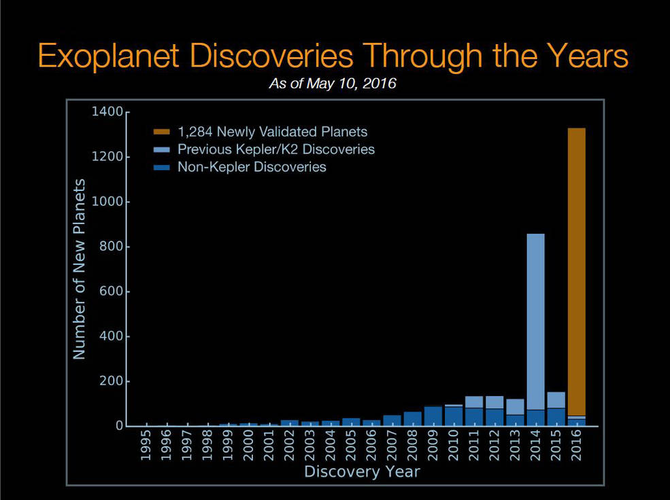
2009 – 2013, as K2: 2013 – now
Notes:
and in between the size of neptune and mercury or earth, we have this sample of exoplanets for which we don’t have solar system analogs for. Their composition becomes a very interesting questions, and a good start of answering that question is through the bulk density of the planets, which means measuring their masses.

Slide 5
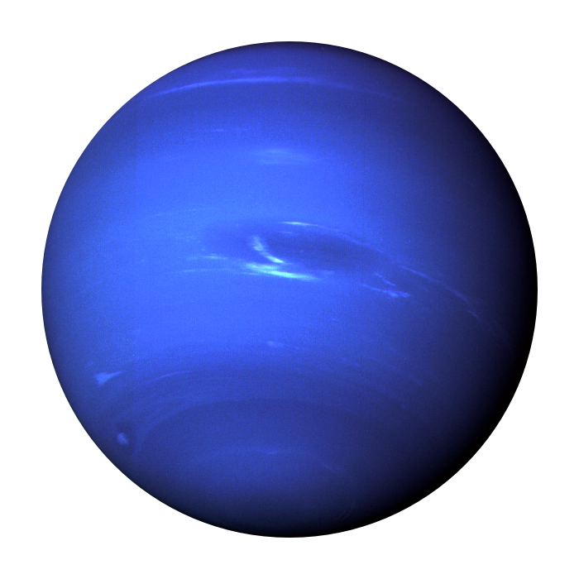
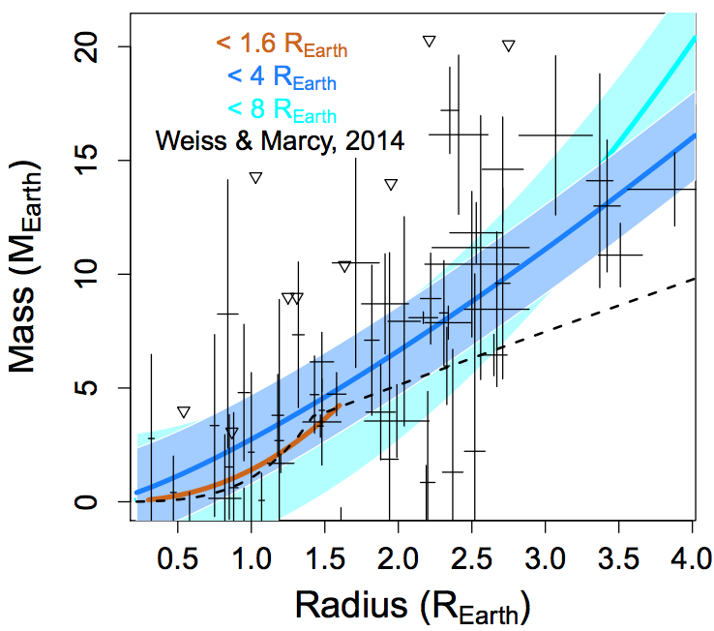
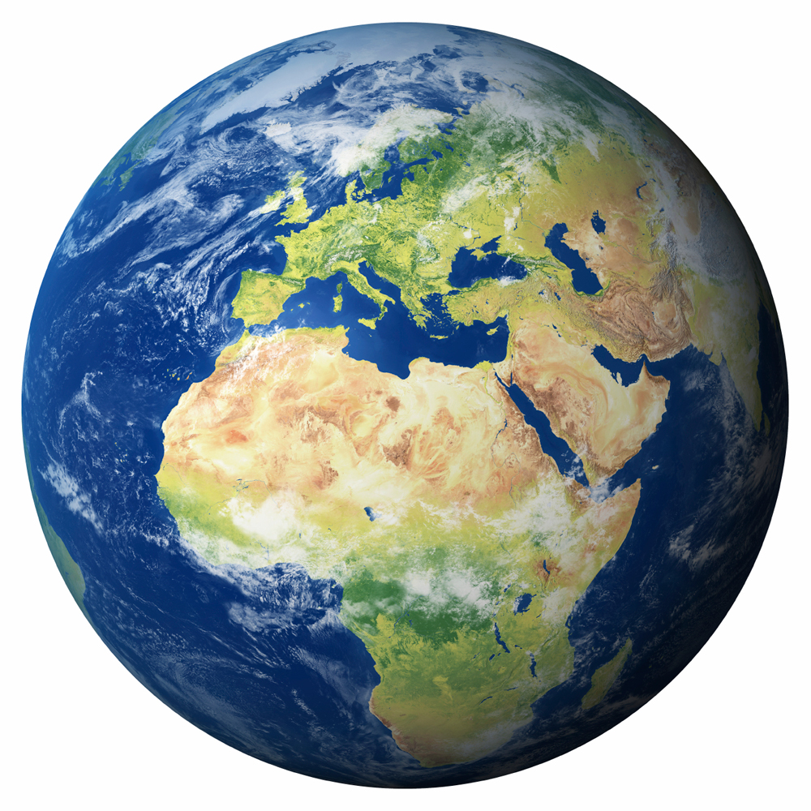
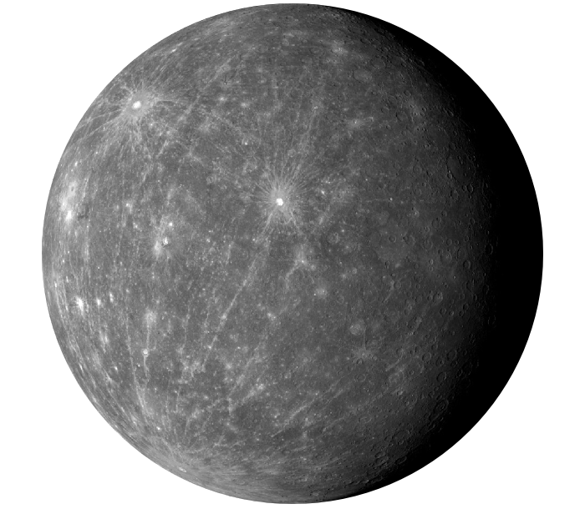
Keck is the working horse for Kepler planet mass measurement
Wolfgang et al. 2015
Notes:
This is a plot from Wolfgang et al. 2015, a mass radius diagram for the small exoplanets. The lines with shaded regions are the derived mass distribution, but unfortunately due to the limited sample, we don’t have a handle on planets smaller than 1.6 earth radius, which are the most likely rocky ones. As you can see the error bars on these points occupy half of the diagram. So how can we improve the situation? We need to shrink the error bars and populate this plots with more planets. Most of the planets on here are discovered by Kepler and later had their masses measured via ground-based RVs. And for doing massive follow-ups on a large sample of planet host stars with either Kepler or TESS, we need large apertures.

Slide 6
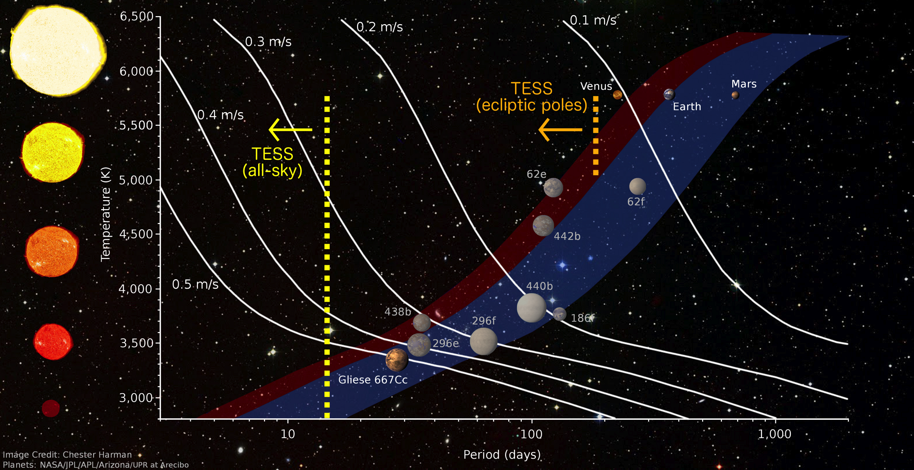
the role of precise Doppler spectroscopy in the quest for Earth 2.0
image courtesy of Chester Harman and Ravi Kopparapu
Notes:
it’s not only about measuring mass for transiting planets. RV itself will play an important role in finding Earth 2.0. This is a plot of stellar temperature vs. orbital period, blue is the habitable zone. The periods that the TESS mission is sensitive to is drawn in the dashed lines. TESS is not sensitive to earth like planet around sun like stars. it’ll be the job of RV, but the precision required is high.

Slide 7
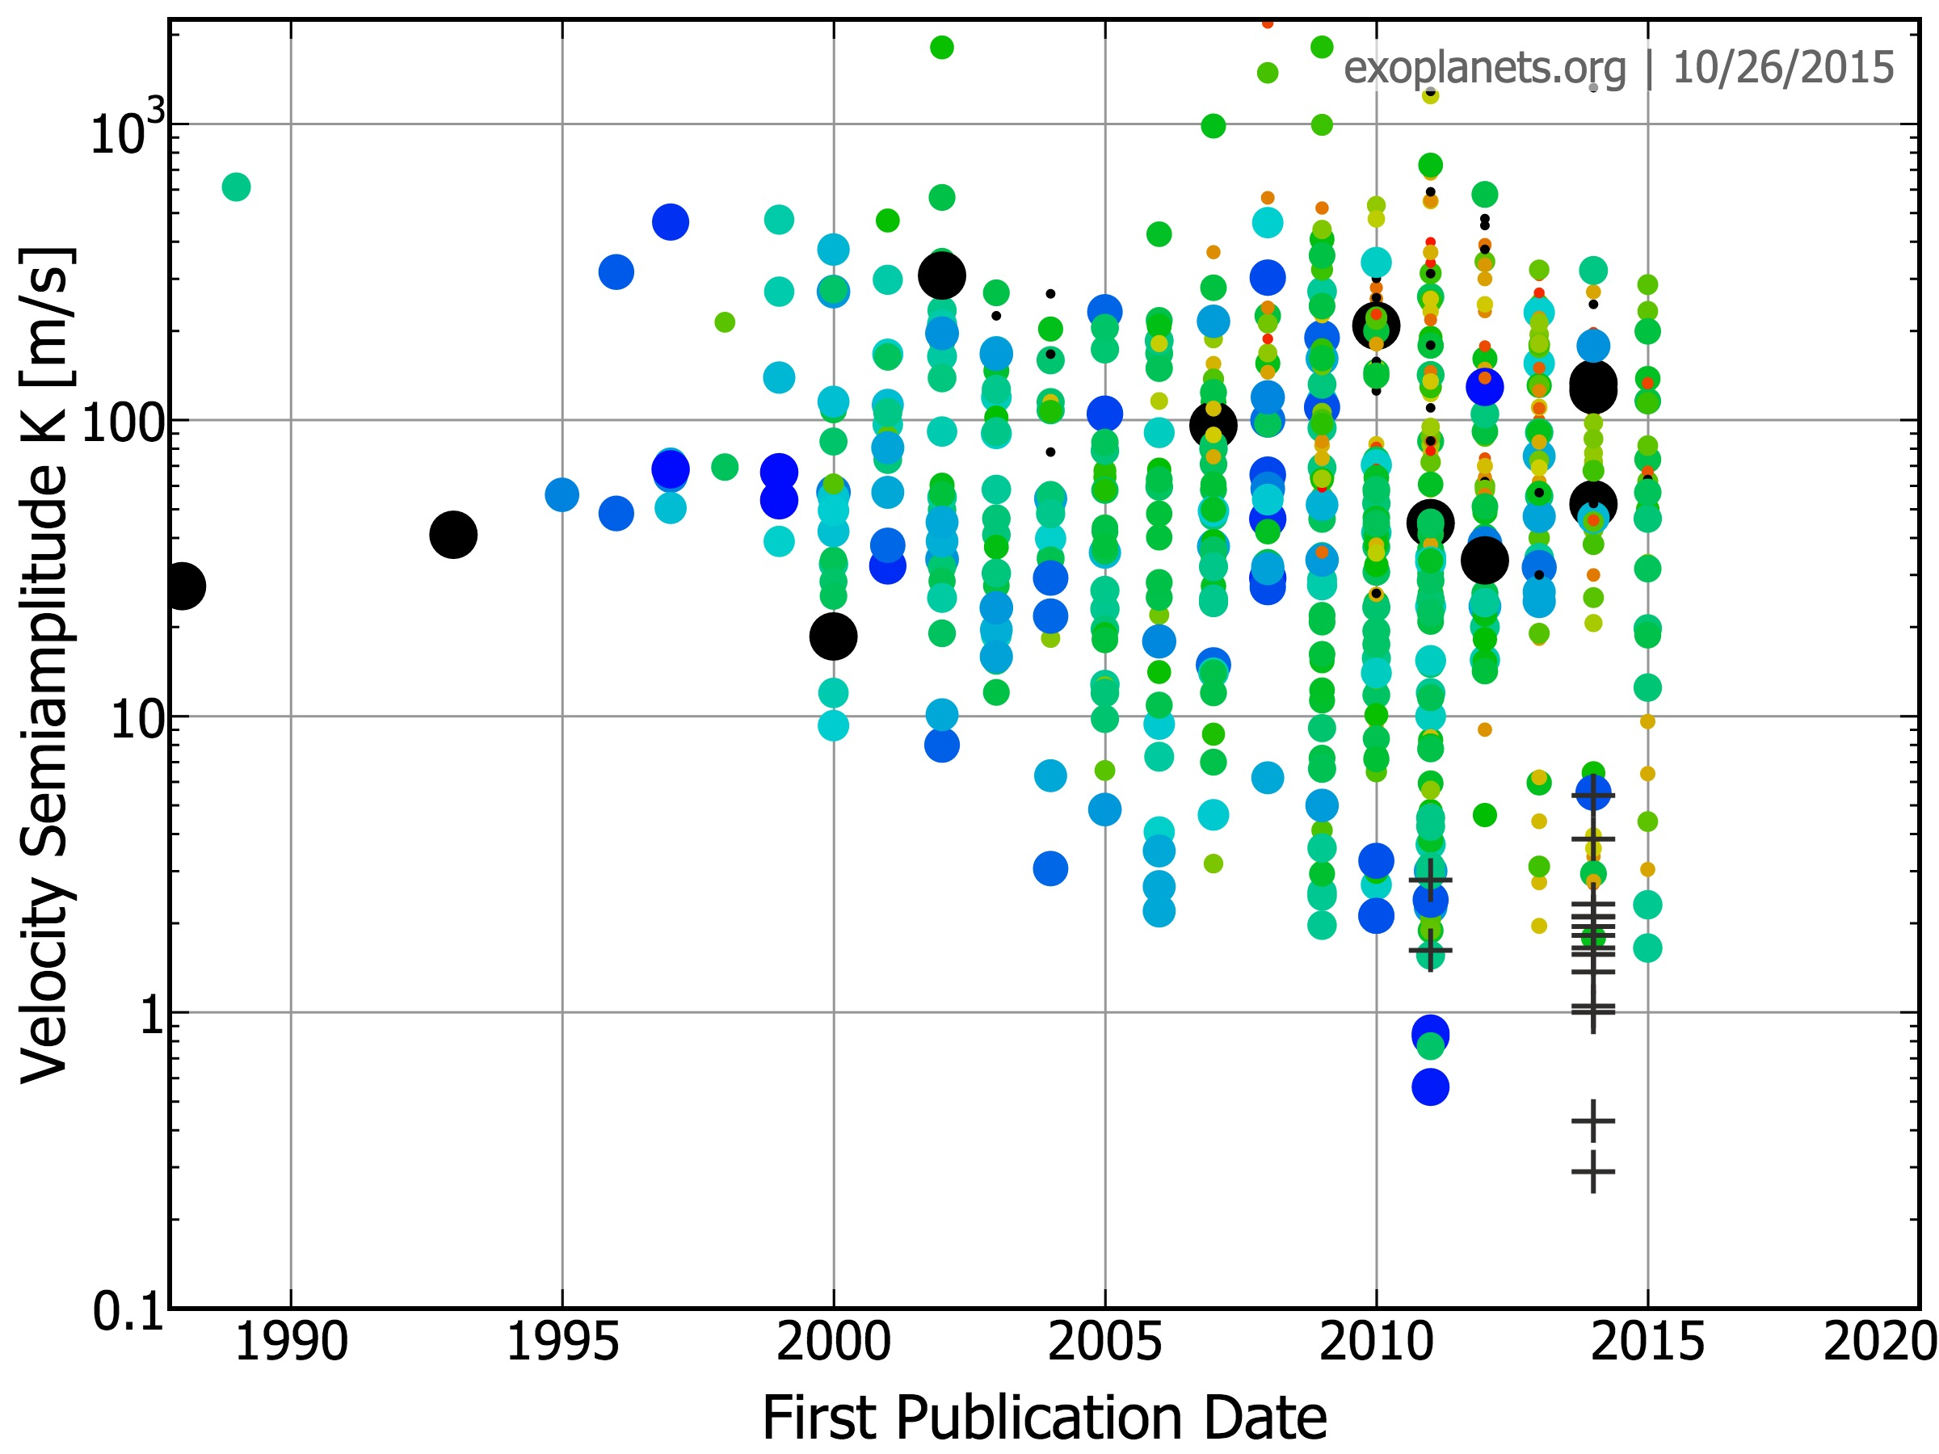
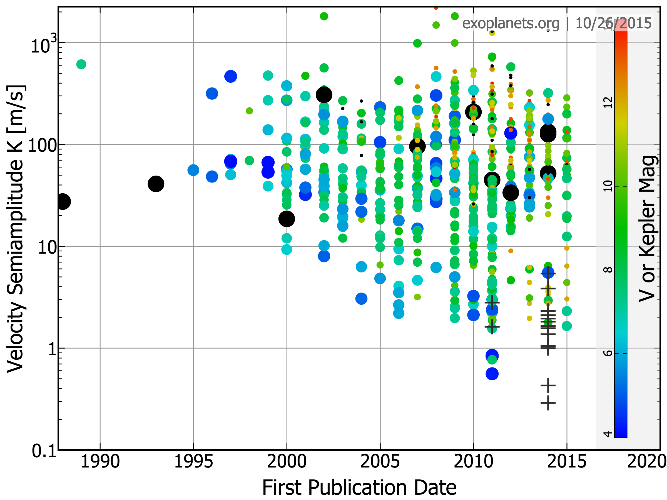
current RV precision ~ 1-2 m/s
12
10
V or Kepler Magnitude
8
6
4
2 m/s
Marcy+ 2014 upper limits
Notes:
I’m not saying that 1-2m/s is bad. It is an exquisite precision, and we’ve come a looong way to reach it. This is a plot of all the RV-detected exoplanets. x-axis is date of discovery and y-axis is the RV semi-amplitude in m/s. You can see in the past two decades we’ve come down from hundreds of meters per second down to 1-2. But we kind stalled at the 1-2 m/s precision for a while…

Slide 8
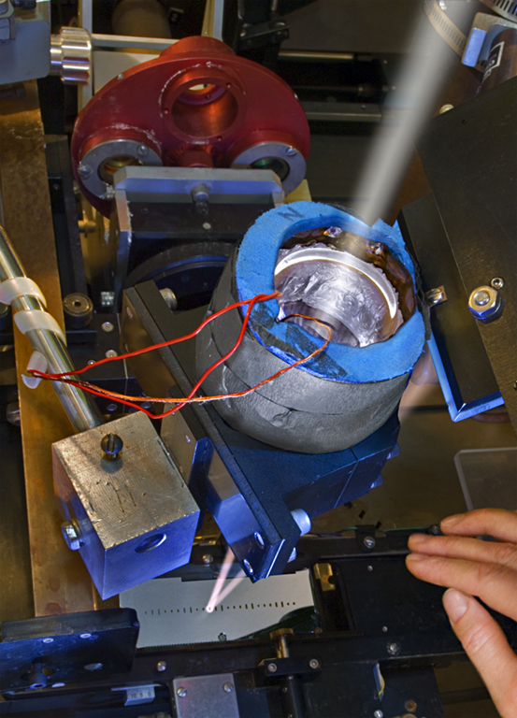
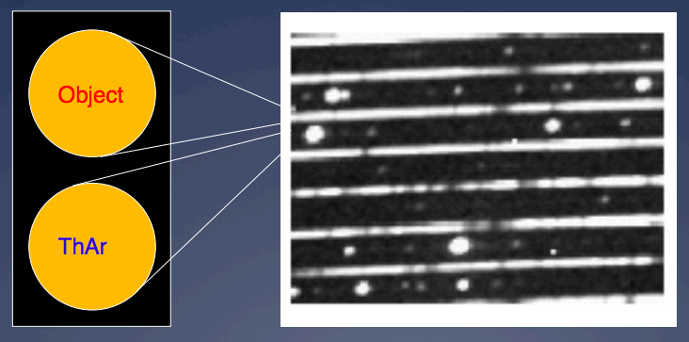
Iodine-Calibrated
Keck HIRES*
Magellan PFS*
Lick APT*
SONG*
SMARTS CHIRON*
HET HRS*
AAT UCLES*
UVES on VLT
Tull on 2.7m
Hamilton on Lick*
*have used the same Doppler pipeline
copy right LaurieHatch.com
ThAr-Calibrated
HARPS-S
HARPS-N
PARAS
SOPHIE+
AST TOU
slide from Christophe Lovis
Notes:
This is what the field looks like today. There are roughly two types of precise RV instruments according to their wavelength calibrators. One uses iodine where light passes through an iodine cell before it enters the spectrograph. One uses ThAr lamp, where you have simultaneous ThAr traces next to your stellar spectrum. These instruments all have pretty high precision, about 1-2 or up to 3-6 m/s. I’ve highlighted Keck/HIRES here, which is what this talk will focus on today. And I just want to point out that almost all iodine RV instruments use the same doppler pipeline or a variation of it, which Paul Butler wrote for Lick and Keck two decades ago.

Slide 9
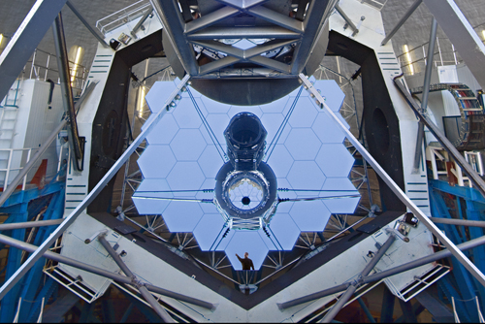
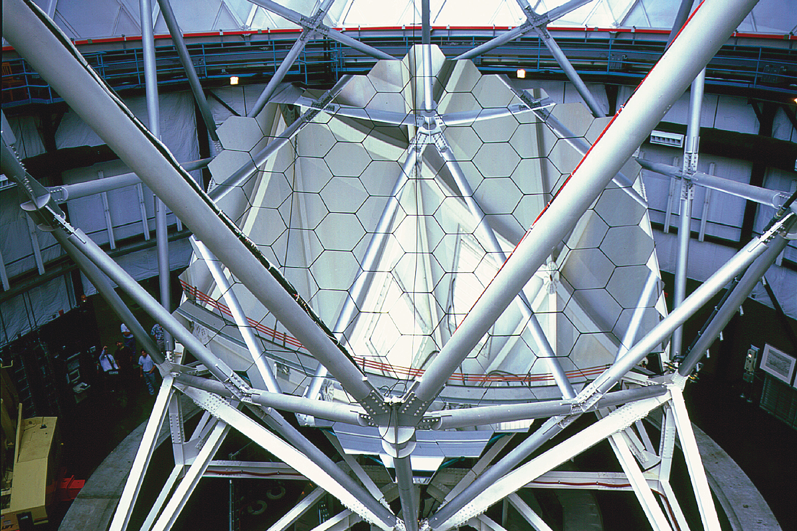
the only 2 northern large telescopes
with precise RV capability:
Keck Telescope
High Resolution Echelle
Spectrometer (HIRES)
Hobby-Eberly Telescope (HET)
High Resolution Spectrograph (HRS)
McDonald Observatory, TX
iodine cell calibrator
Notes:
So these are the only two large telescopes in the northern hemisphere with real precise RV capability. Keck, with its HIRES, and HET with its HRS. They both use iodine cells as calibrators, and will remain so in the next 5 years, so well into the TESS era. My thesis is set out to improve the precision of these two telescopes. I’ll first start with my work with Keck, which has been the working horse for Kepler follow-up.

Slide 10
forward modeling precise RV spectra
“true”
(model)
iodine atlas
stellar template
– iodine lines
– stellar lines
• observation
observed

Slide 11
3 m/s
fiber-fed
being upgraded now
> 10 years of precise RV data
get the most out of HET/HRS

Slide 12
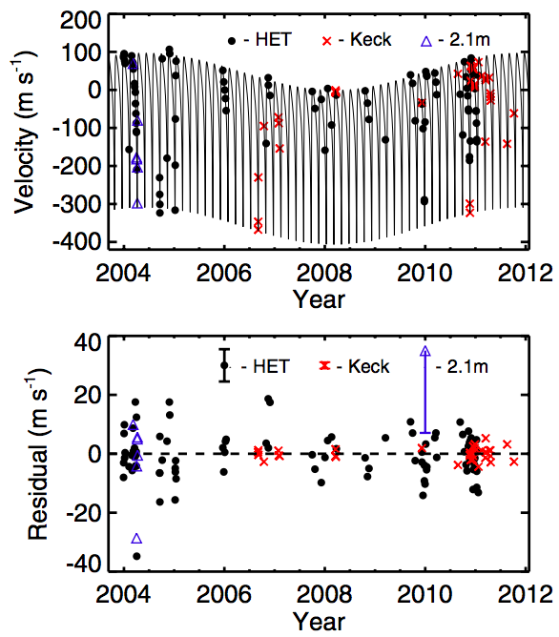
discovery of HD 37605c
Wang et al. (2012)
Notes:
HD 37605c, which is the 10th Jupiter analog ever found, 3 jup mass, 7.5 year orbit.
37605b was first planet discovered by HET lead by the Texas Austin team, 3 jup mass, 55 days orbit.
This was a joint discovery with Austin team, Bill Cochran, Phillip McQueen and Michael Endl where they provided all of their archival data.
Bottom plot shows the residuals, which is a good illustration of comparison between Keck precision and HET.

Slide 13
discovery of HD 37605c
why only 3-5 m/s?
Wang et al. (2012)
Notes:
HD 37605c, which is the 10th Jupiter analog ever found, 3 jup mass, 7.5 year orbit.
37605b was first planet discovered by HET lead by the Texas Austin team, 3 jup mass, 55 days orbit.
This was a joint discovery with Austin team, Bill Cochran, Phillip McQueen and Michael Endl where they provided all of their archival data.
Bottom plot shows the residuals, which is a good illustration of comparison between Keck precision and HET.

Slide 14
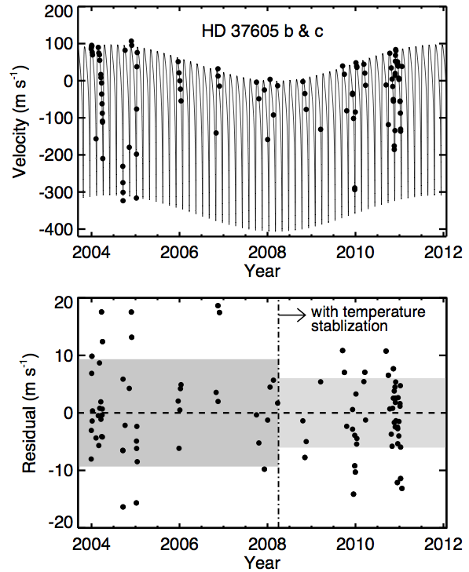
temperature stabilization was an issue

Slide 15
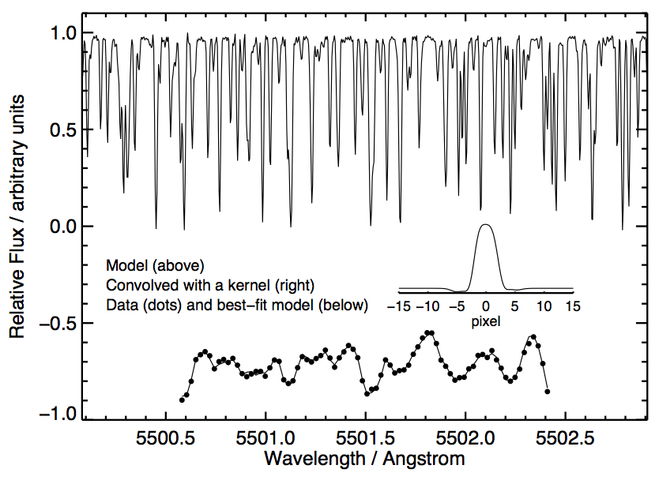
fits for iodine frames are good diagnoses
IP
Instrumental Profile

Slide 16
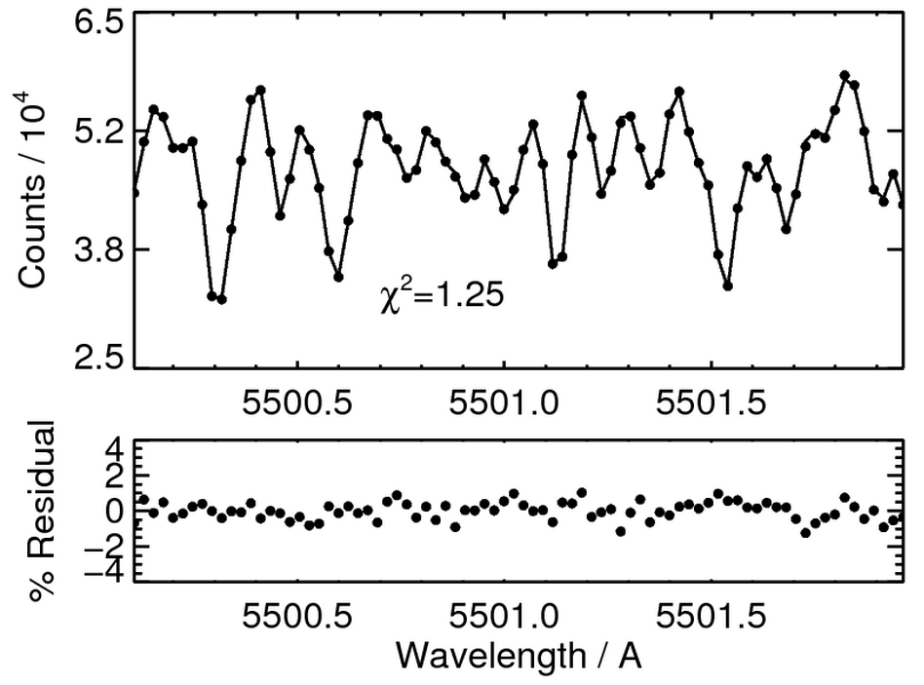
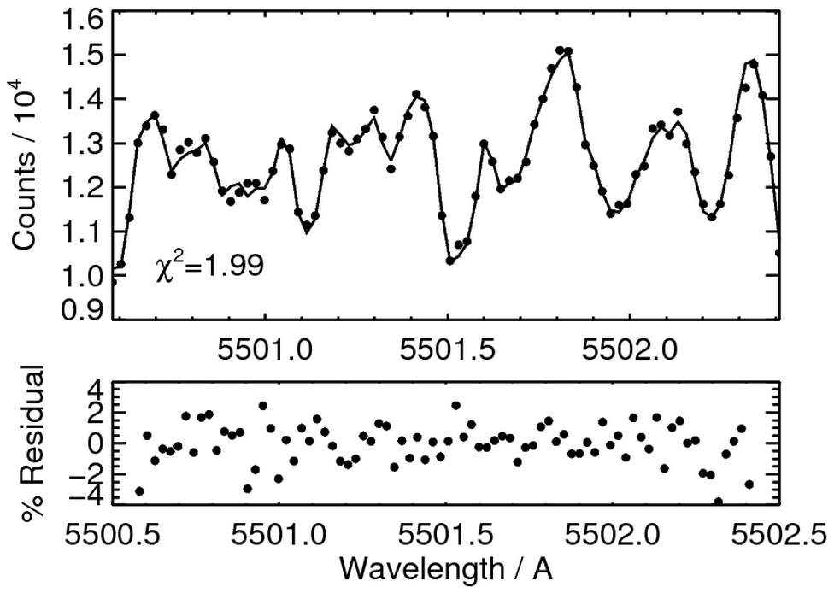
Keck/HIRES
iodine atlas fits observation well
HET/HRS
iodine atlas does NOT fit
Notes:
Now back to the mystery of HRS. One of the powerful diagnosing tools is to fit the iodine absorption lines alone, using an iodine atlas taken by a fourier transform spectrograph as the input model. For Keck they fit their iodine lines really well, which means we have good knowledge of the iodine cell and the instrument PSF. At HET, not so much. So it turns out this is a two fold problem tangled together. First, we haven’t found the perfect functional form to describe the HRS PSF, unlike Keck. And the second reason is that we suspect the input iodine model, the iodine atlas, is insufficient.

Slide 17
fits for iodine frames are good diagnoses
3
2
1

Slide 18
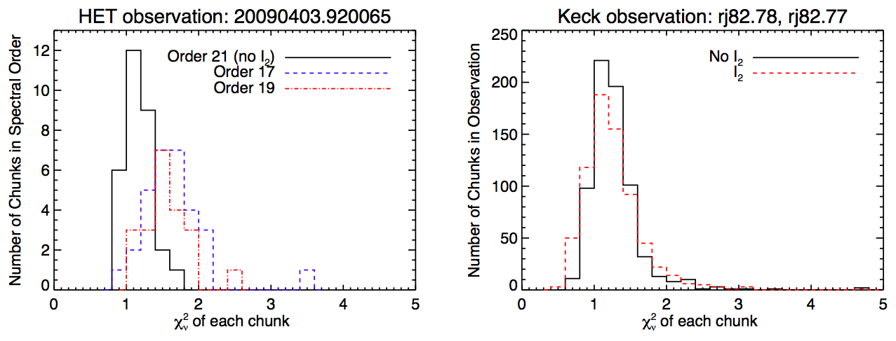
raw reduction is probably fine

Slide 19
fits for iodine frames are good diagnoses
3
2
1

Slide 20
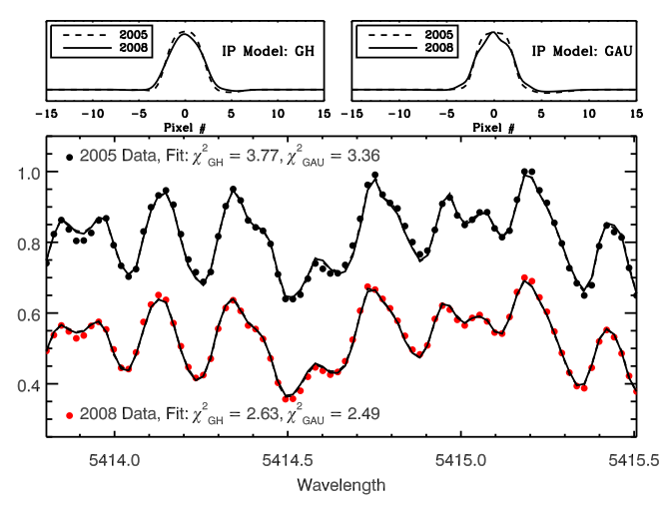
different IP functions are equally bad and don’t converge onto the same one

Slide 21
fits for iodine frames are good diagnoses
3
2
1

Slide 22
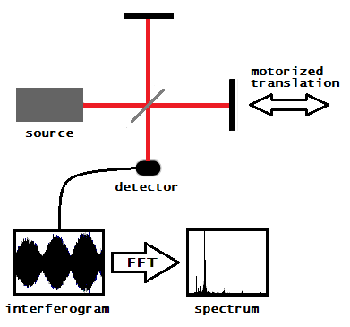
Fourier Transform Spectrograph (FTS)
provides high-resolution, wavelength calibrated spectrum.
image credit Stigmatella aurantiaca from wikipedia

Slide 23
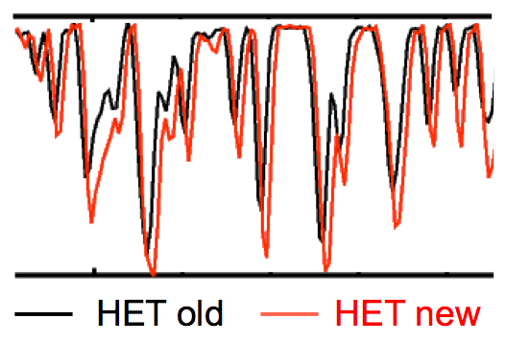
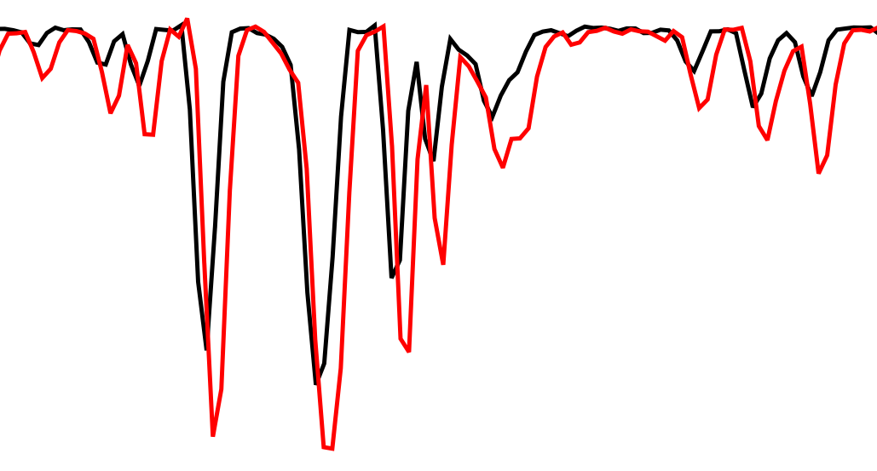
two FTS scans of HET/HRS cell show significant differences
1993 @ KPNO
2011 @ NIST
Notes:
How to tell which is right? Go to the real space!

Slide 24
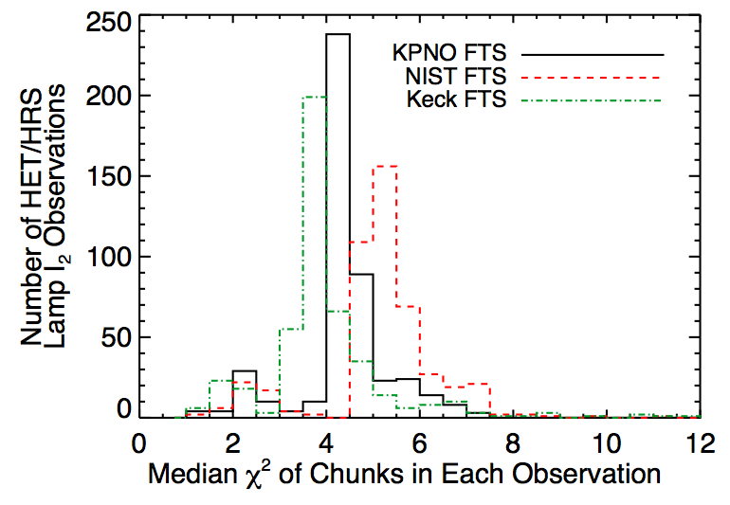
the NIST FTS is “wrong”?

Slide 25
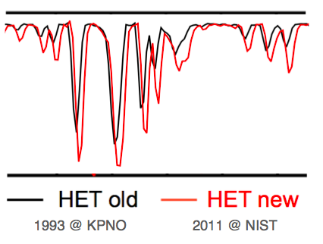
questions
answers
?
Keck
KPNO
?
NIST

Slide 26
the perfect echelle spectrograph for validating FTS scans
almost
Tull Spectrograph
Resolution ~ 500,000
TS12 setting
Coudé @ McDonald 2.7-m Harlan J. Smith Telescope
2 Å per frame, ~ 30-60 Å per day
Notes:
why 30 per day?!

Slide 27
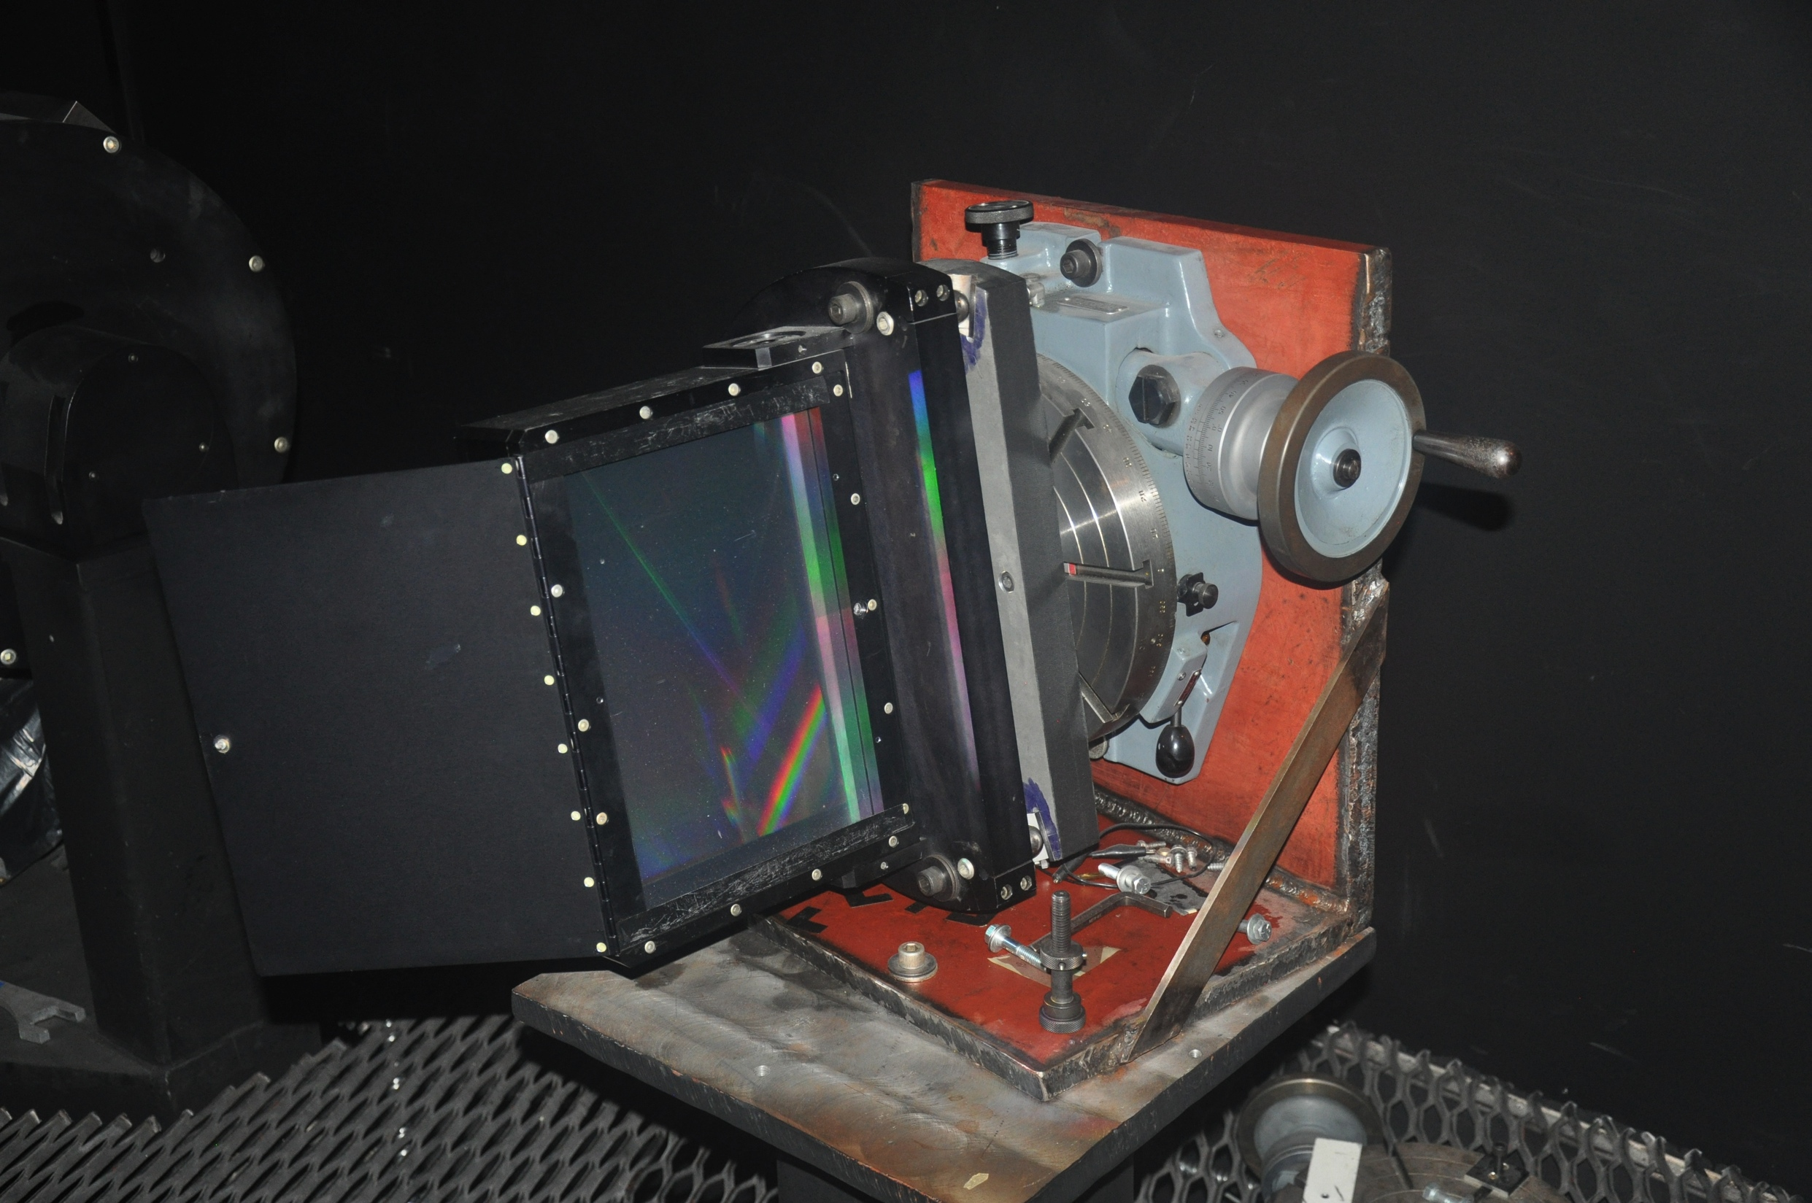
Photo by David Doss @ McDonald

Slide 28
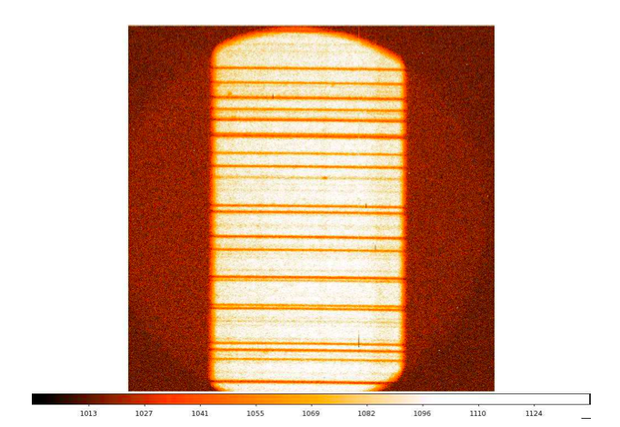
TS12 raw spectral image

Slide 29
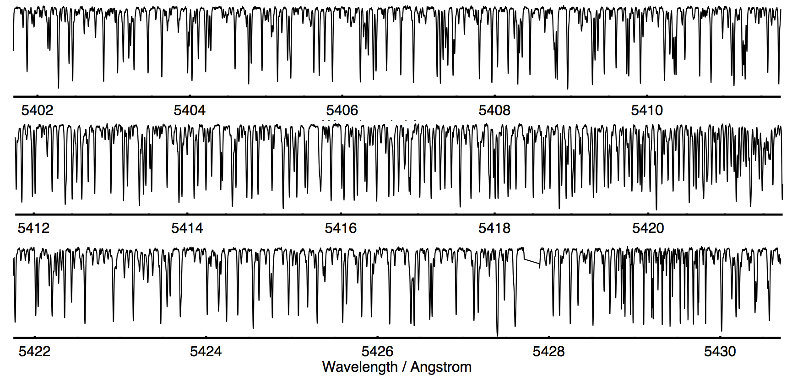
R ~ 500,000 Echelle Spectrum of the 2.1m Iodine Cell
with Ming Zhao
Notes:
clarify it’s not the HET cell!!
don't challenge. solicite help and advice.

Slide 30
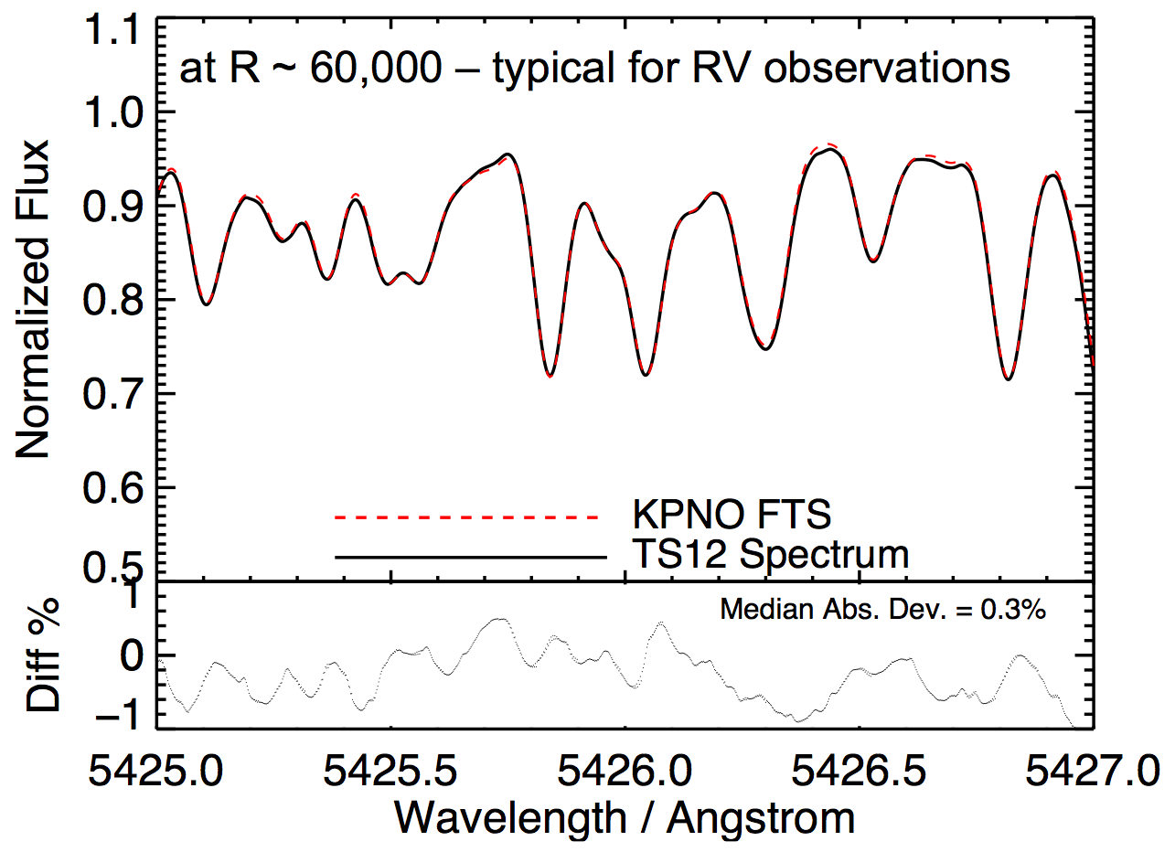
KPNO FTS Scan of 2.1m cell validated echelle spectrum is up for the job
Notes:
and this coming week we’ll do the same validation test for another 4 cells.

Slide 31
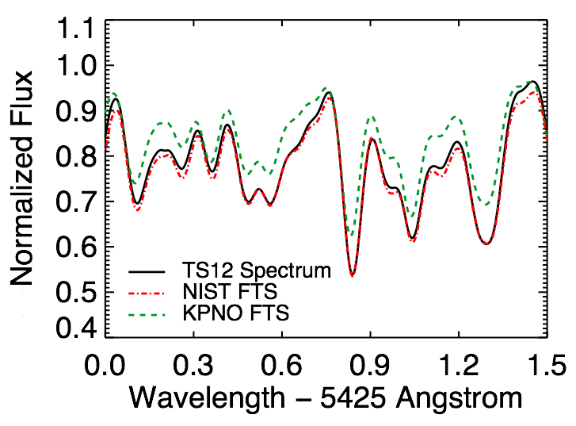
HET/HRS cell: echelle spectrum matches new FTS
echelle spectrum
NIST FTS
KPNO FTS

Slide 32
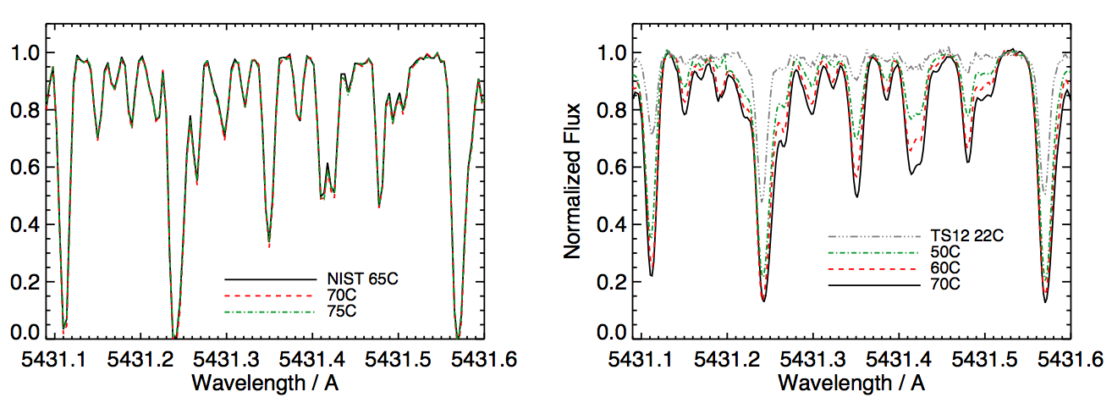
no line changes with temperature in NIST scan
significant line changes with temperature in TS12 spectra

Slide 33
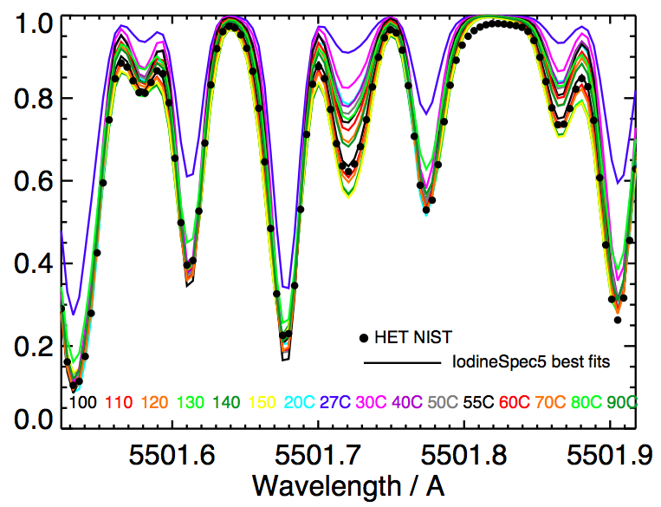
NIST scan was at 110°C?!

Slide 34
ok… but why TS12 spectrum matches with NIST scan? why NIST scan fits the worst?
echelle spectrum
NIST FTS
KPNO FTS

Slide 35
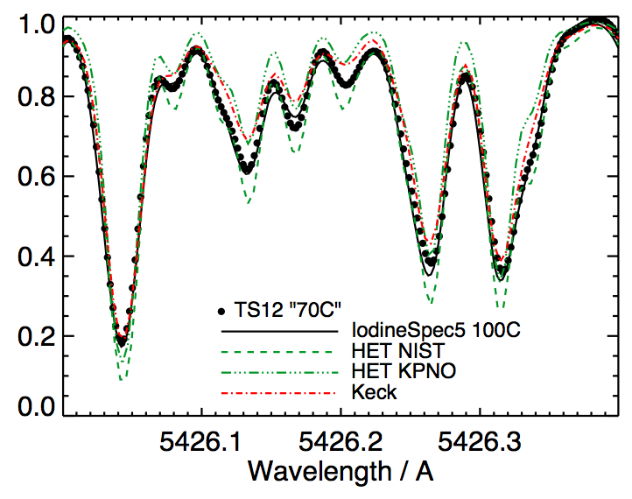
the HET iodine cell is NOT at 70°C!

Slide 36
questions
answers
NIST scan was at a higher temperature, calibrated with a different iodine line list.
Keck
The line depths of the true HET iodine cell spectrum are often in between 70°C and 110°C, looking more similar like Keck’s.
KPNO
NIST

Slide 37
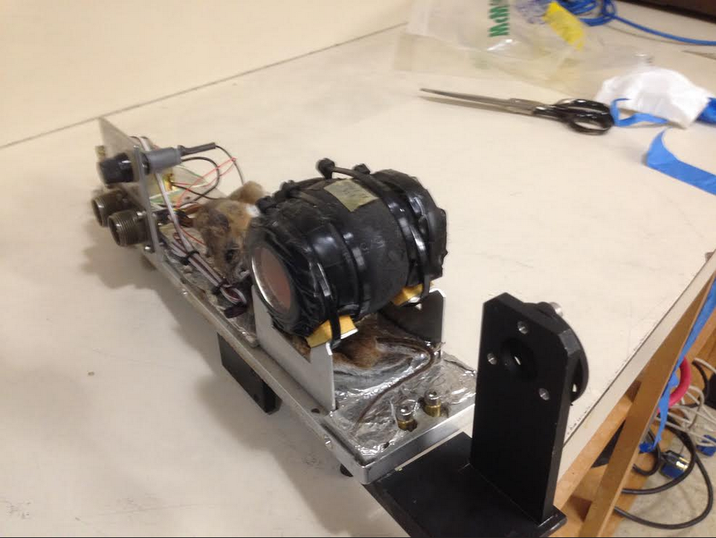
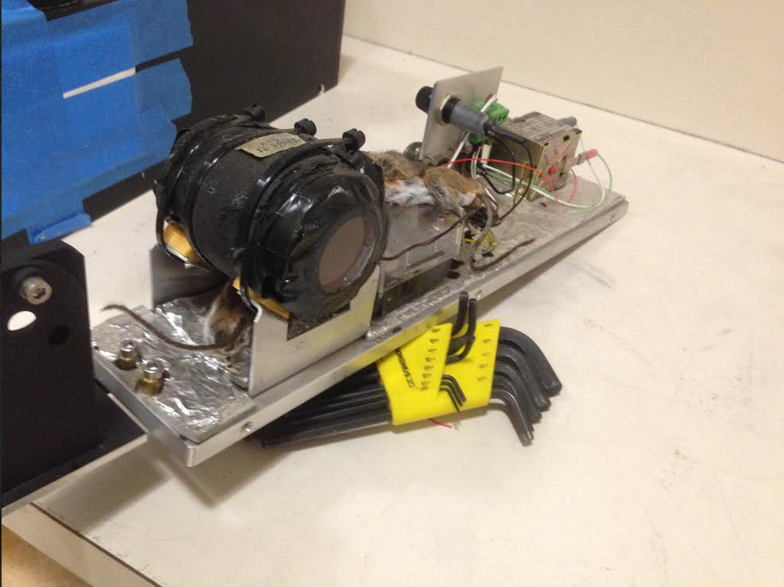
unreliable temperature control? mice in the old enclosure…
…but the TS12 spectrum was taken with the new enclosure!

Slide 38
plans for HET/HRS:
instrument is being upgraded right now
+ validate the temperature control
+ re-scan iodine cell at different temperatures
+ explore better IP models
will also improve the precision of the >10 years of archival data

Slide 39
the only 2 northern large telescopes
with precise RV capability:
Keck Telescope
High Resolution Echelle
Spectrometer (HIRES)
Hobby-Eberly Telescope (HET)
High Resolution Spectrograph (HRS)
McDonald Observatory, TX
iodine cell calibrator
Notes:
So these are the only two large telescopes in the northern hemisphere with real precise RV capability. Keck, with its HIRES, and HET with its HRS. They both use iodine cells as calibrators, and will remain so in the next 5 years, so well into the TESS era. My thesis is set out to improve the precision of these two telescopes. I’ll first start with my work with Keck, which has been the working horse for Kepler follow-up.

Slide 40
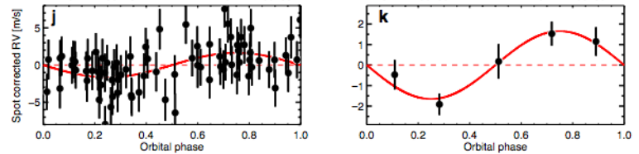
we need better RV precision!
RV
Orbital Phase
Orbital Phase
Kepler 78b
Earth mass, Earth size
Howard et al. 2013
Keck HIRES
Jitter ~ 2.1 m/s
RV Amp ~ 1.7 m/s
Notes:
example from andrew’s paper

Slide 41
Keck precision on a RV standard star
sigma Draconis (HD 185144)
Notes:
standard practice – look at RV standard star

Slide 42
a > 1 m/s systematic error!
sigma Draconis (HD 185144)
Notes:
a powerful way to spot systematic errors is to plot RV against barycentric correction velocity of the star. That is the star’s velocity with respect to the observatory due to the earth motion around the sun.

Slide 43
forward modeling precise RV spectra
“true”
(model)
iodine atlas
stellar template
– iodine lines
– stellar lines
• observation
observed

Slide 44
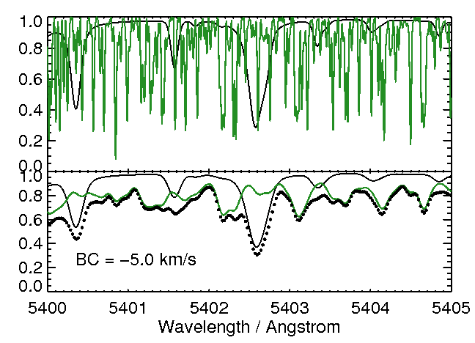
systematics like to correlate with BC: the largest RV signal is the Earth
“true”
(model)
iodine atlas
stellar template
observed

Slide 45
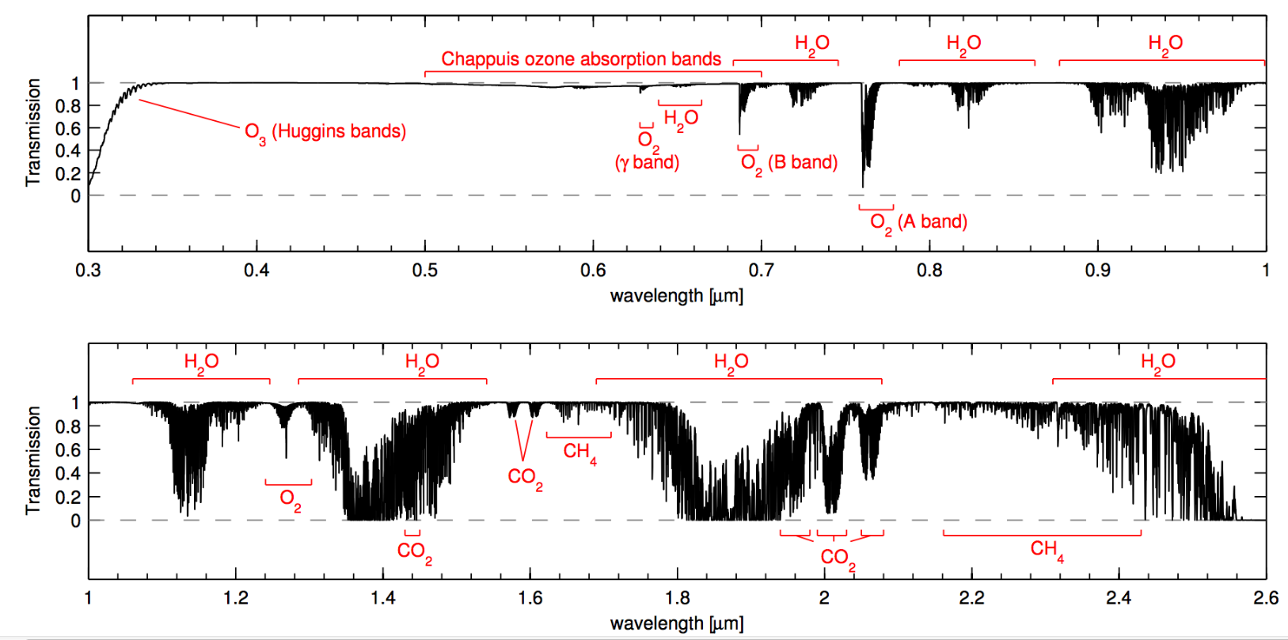
telluric lines = spectral contamination
Smette et al. (2015)
500nm
1μm
1μm
2.6μm

Slide 46
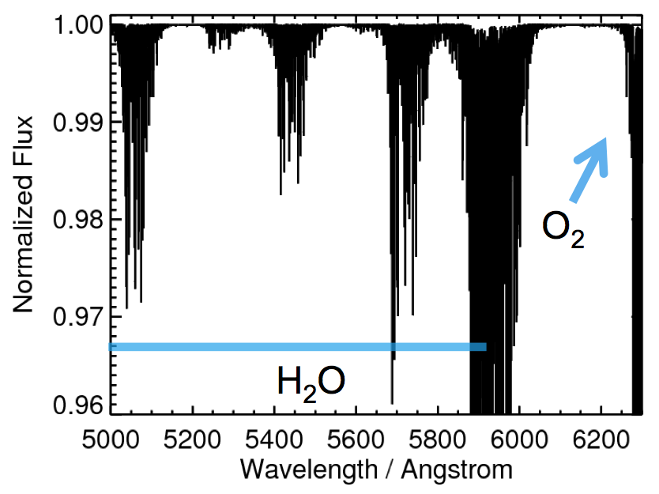
micro-tellurics in iodine spectral region
generated using TERRASPEC, Bender et al. 2012

Slide 47
complete end-to-end simulation of the Keck Doppler pipeline
true
(model)
iodine atlas
stellar template
(synthetic spectrum)
observed
(synthetic)

Slide 48
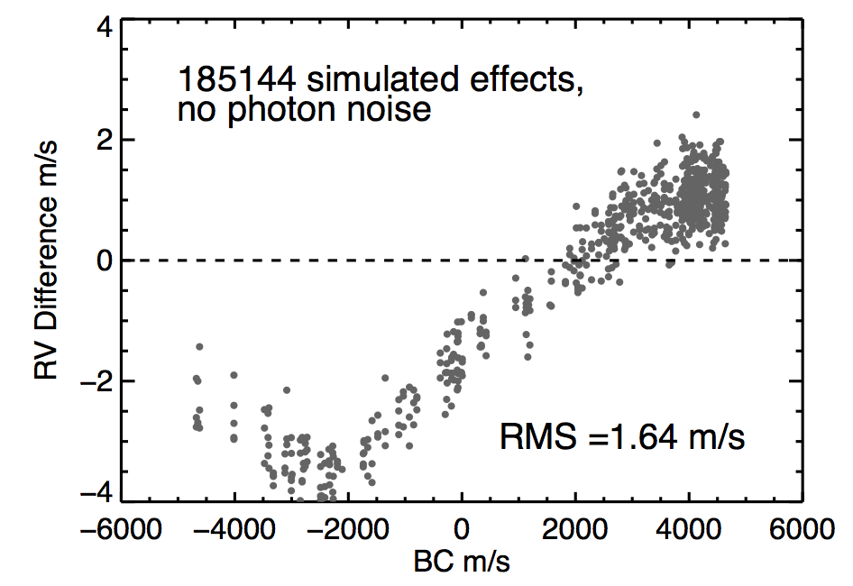
tellurics make a difference!
HD 185144, no photon noise
perfectly stable spectrograph

Slide 49
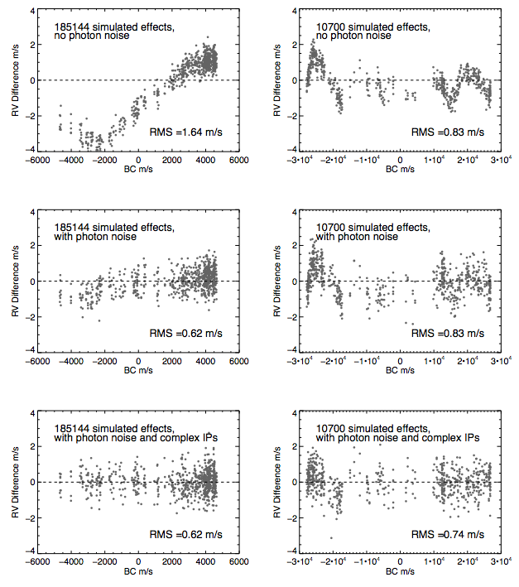
HD 185144
HD 10700
add noise
add varying IP
telluric contamination is bad for RV precision, especially for high SNR observations and stabilized spectrograph
But Maybe OK for Keck/HIRES

Slide 50
remedies for telluric contamination:
tested with Keck Doppler pipeline
+ forward model the telluric lines
+ clean up the tellurics in stellar template
FYI: masking out the telluric lines – not the best idea

Slide 51
but what is behind the 1 m/s systematics?
sigma Draconis (HD 185144)
Notes:
we used synthetic spectrum as stellar template

Slide 52
forward modeling precise RV spectra
“true”
(model)
iodine atlas
stellar template
– iodine lines
– stellar lines
• observation
observed

Slide 53
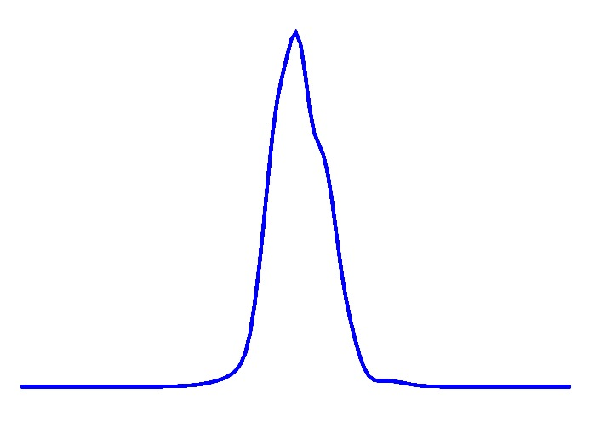
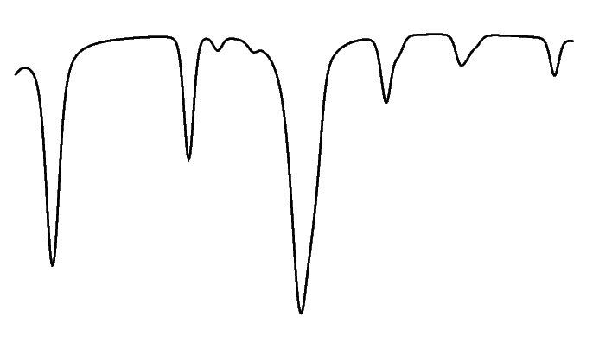
simulate the deconvolution process
observed stellar spectrum
iodine (nearby B star)
spectral PSF
deconvolved stellar template

Slide 54
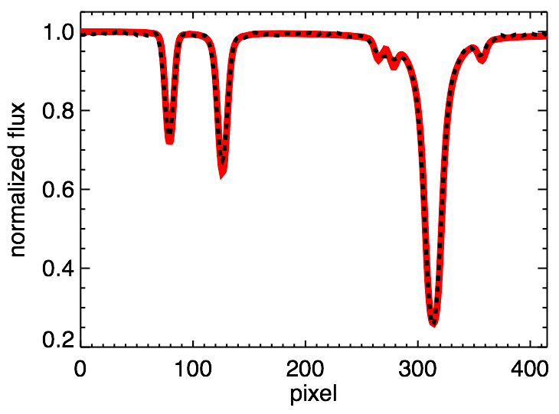
our current deconvolution algorithm is good, but not good enough
synthetic spectrum
deconvolved spectrum
Notes:
dash the black, red much thicker!

Slide 55
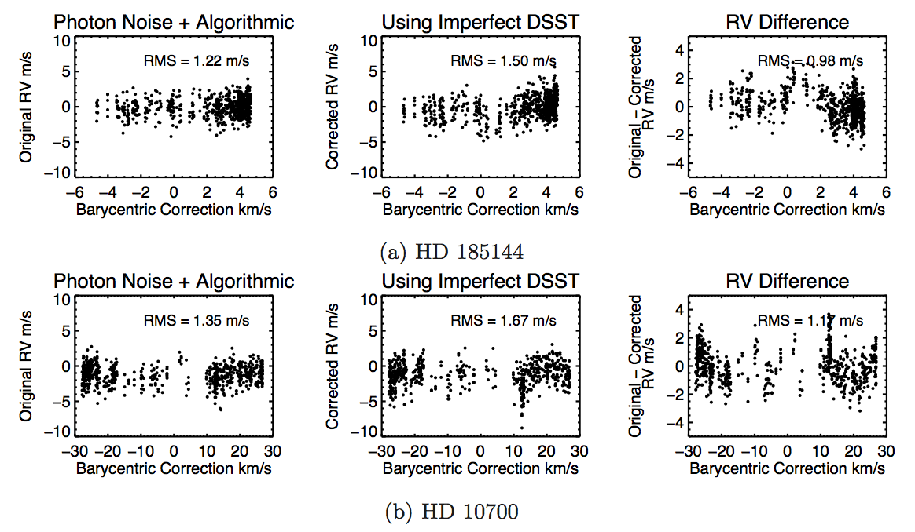
deconvolution error in stellar template: 1 m/s RMS, 1 m/s systematics

Slide 56
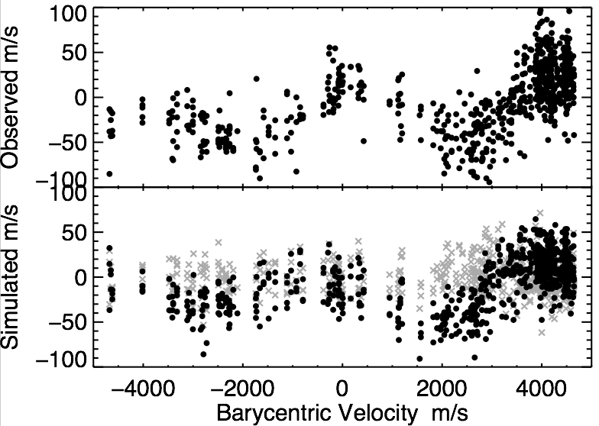
observed systematics reproduced
a selected 2A chunk, no tellurics
observed
RV m/s
simulated
gray = “perfect simulation”
RV m/s
Barycentric Correction m/s
Notes:
the fact that simulation can predict reality
completely reproduced systematic errors from synthetic data.

Slide 57
precision on a ‘standard star’ = 2 m/s
error added by deconvolution = 1 m/s
error added by atmosphere = 0.6 m/s
1.6 m/s
spurious signal at period of 1 year and harmonics
added by deconvolution K = 1 m/s
added by atmosphere K = 0.2 m/s

Slide 58
forward modeling precise RV spectra
“true”
(model)
iodine atlas
stellar template
– iodine lines
– stellar lines
• observation
observed

Slide 59
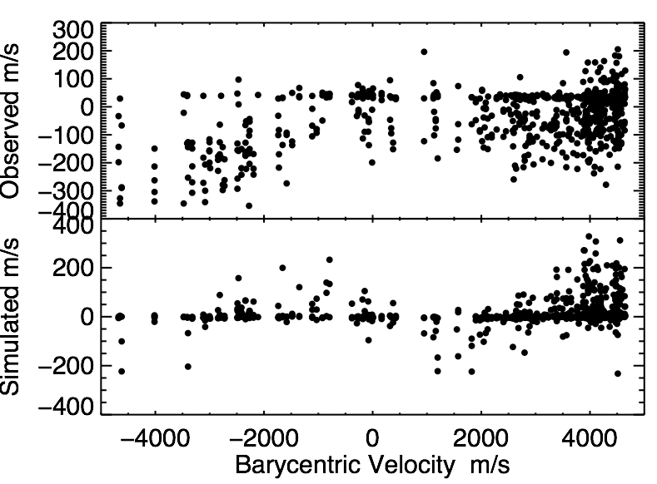
algorithmic errors
a selected 2A chunk, no tellurics
the “perfect simulation” is not perfect
Notes:
convergence issue + wrong minimum
legacy code

Slide 60

the CPS Doppler code is old
The Doppler Lab at SFSU
image from Jason Wright’s blog
Notes:
standard practice – look at RV standard star

Slide 61

the CPS Doppler code is old
Notes:
standard practice – look at RV standard star

Slide 62
Our data analysis tools are outdated
We cannot continue using pre-1990s tools to solve post-2010s problems

Slide 63

exciting future opportunities
Notes:
I’m not saying that 1-2m/s is bad. It is an exquisite precision, and we’ve come a looong way to reach it. This is a plot of all the RV-detected exoplanets. x-axis is date of discovery and y-axis is the RV semi-amplitude in m/s. You can see in the past two decades we’ve come down from hundreds of meters per second down to 1-2. But we kind stalled at the 1-2 m/s precision for a while…

Slide 64

The Future
A New RV Code
Python, GitHub, Bayesian
MCMC + gaussian processes
Foreman-Mackey et al. 2013
Czekala et al. 2014

Slide 65

Kepler 452b NASA Ames/JPL-Caltech/T. Pyle
An exciting future in
detecting Earth 2.0
via precise Doppler spectroscopy!
reproduced and identified dominant systematics in HET & Keck RVs
interrogated every aspect of precise iodine work
moving forward with a new Doppler pipeline for next-generation facilities

Slide 66
Many Thanks
and many partings
Thanks to my advisor, Jason Wright.
Thanks to my committee for advice and guidance (which indirectly landed me a job).
Thanks to Ming Zhao, Kim Cartier, and Joey Schmitt for their heroic efforts at TS12.
Thanks to Andrew Howard and Howard Isaacson for Keck data.
Thanks to NASA/NESSF for two years of funding.
Thanks to everyone in this department for the wonderful eight years.

Slide 67



likelihood to posterior, optimization to integration
plus uninformative prior
Notes:
15 dimensions, point estimator

Slide 68


credit: Ian Czekala

Slide 69


credit: Dan Foreman-Mackey

Slide 70

credit: Ben Nelson

Slide 71

flux
z = z_{star} + z_{planet}
t = t₀
t = t_{e}
wavelength

Slide 72
flux
z = z_{star} + z_{planet}
t = t₀
t = t_{e}
wavelength

Slide 73

Jupiter analogs are emerging
Notes:
The jupiter analogs. The first planets discovered are all hot jupiters… formation… jupiter analogs are important.
Jupiter, 5AU, 12 year orbit, low eccentricity.
Analogs > 7 years, 0.5-4 jupiter mass, low eccentricity < 0.3.

Slide 74

discovery of HD37605c
Wang et al. (2012)
Notes:
b: 55 days, high ecc. c: almost 8 years, low ecc, and both are roughly 3 jupiter masses.

Slide 75
discovery of HD37605c
Transit Ephemeris Refinement and Monitoring Survey (TERMS)
led by Stephen Kane
Wang et al. (2012)
Notes:
the discovery story…
as time goes by you lose predictability of transit timing.
then estimate how well we can predict the transit center.

Slide 76
BOOTTRAN
error bars for Keplerian fit via bootstraping
provides transit centers and error bars
compatible with RVLIN package
available at exoplanets.org/code, in IDL
Notes:
Bootstrap to get sampling distribution
plug and go
full formula and statistical arguments
Compared with MCMC in paper

Slide 77

SMG-AGNs are not special?
Wang et al. 2013

Slide 78

Inverse metallicity profile in LSBs?
MUSCEL: multiwavelength study of the structure, chemistry, and evolution of LSBs
Young, Kuzio de Naray, & Wang, 2015

Slide 79

lots of highly obscured AGNs in low-mass galaxies?
Xue, Wang, et al. 2012

Slide 80

systematics like to correlate with BC: the same bias at the same BC
“true”
(model)
iodine atlas
stellar template
observed

Slide 81
systematics like to correlate with BC: the same bias at the same BC
“true”
(model)
iodine atlas
stellar template
observed

Slide 82
what gives persistent RV errors?
“true”
(model)
4
iodine atlas
3
stellar template
5
2
observed
1

Slide 83
what gives persistent RV errors?
1
barycentric correction
observed spectra
stellar template
iodine atlas
algorithm
2
3
4
5

Slide 84
what gives persistent RV errors?
Wright & Eastman 2014
1
barycentric correction
observed spectra
stellar template
iodine atlas
algorithm
2
3
4
5

Slide 85
what gives persistent RV errors?
1
barycentric correction
observed spectra
stellar template
iodine atlas
algorithm
2
3
4
5

Slide 86
what gives persistent RV errors?
1
barycentric correction
observed spectra
stellar template
iodine atlas
algorithm
2
3
4
5

Slide 87
what gives persistent RV errors?
1
barycentric correction
observed spectra
stellar template
iodine atlas
algorithm
2
3
4
5

Slide 88
what gives persistent RV errors?
1
barycentric correction
observed spectra
stellar template
iodine atlas
algorithm
2
3
4
5

Slide 89
tellurics in precise RV: from path to byway
1973 Griffin & Griffin O₂ as calibrator -> 10 m/s
2010s 5-20 m/s both optical & NIR
Barnes+2012, Blake+2010, Figueira+2010a
2010 Bean et al. 5 m/s with CRIRES
NIR tellurics = bottleneck!

Slide 90
The issue of telluric contamination
must be properly addressed
in all high-precision RV surveys
for a summary on the issue and recommendations:
bit.ly/eprv_telluric_summary

Slide 91

observed
simulated
180d
360d
deconvolution errors can mimic planet signal at ~1 m/s level with periods at harmonics of ~1 year

Slide 92


a planet around sigma Draconis?
Vogt et al. 2014
Msini ~ 11 Me, P ~ 310 days
4
RV
-4
Phase
deconvolution errors can mimic planet signal at ~1 m/s level with periods at harmonics of ~1 year

Slide 93
This is a solvable problem!
Deconvolution is an active research topic in engineering, medicine, astronomy, etc., with many, many well-studied algorithms.

Slide 94


Launch Date: August 2017

Slide 95
the role of precise Doppler spectroscopy in the quest for Earth 2.0
image courtesy of Chester Harman and Ravi Kopparapu
Notes:
it’s not only about measuring mass for transiting planets. RV itself will play an important role in finding Earth 2.0. This is a plot of stellar temperature vs. orbital period, blue is the habitable zone. The periods that the TESS mission is sensitive to is drawn in the dashed lines. TESS is not sensitive to earth like planet around sun like stars. it’ll be the job of RV, but the precision required is high.

Slide 96

the 7 components of precise RV
stellar
activity
stable
spectrograph
tellurics
input
data analysis
star
calibrator
credit: Andreas Quirrenbach, Debra Fischer

Slide 97
the 7 components of precise RV
astrophysics
hardware
stellar
activity
stable
spectrograph
software
tellurics
input
data analysis
star
calibrator
credit: Andreas Quirrenbach, Debra Fischer

Slide 98

the 7 components of precise RV
stellar
activity
stable
spectrograph
tellurics
input
data analysis
star
calibrator
credit: Andreas Quirrenbach, Debra Fischer

Slide 99

the 7 components of precise RV
stellar
activity
stable
spectrograph
tellurics
input
data analysis
star
calibrator
credit: Andreas Quirrenbach, Debra Fischer

Slide 100

the 7 components of precise RV
stellar
activity
stable
spectrograph
tellurics
input
data analysis
star
calibrator
credit: Andreas Quirrenbach, Debra Fischer

Slide 101

the 7 components of precise RV
stellar
activity
stable
spectrograph
tellurics
input
data analysis
star
calibrator
credit: Andreas Quirrenbach, Debra Fischer

Slide 102

500 TESS small exoplanets around bright sun-like stars high demand on precise RVs
data from Sullivan et al. 2015
Notes:
most of the measured mass for small planets bear large error bars

Slide 103
future precise RV instruments
Optical
MINERVA at Mt Hopkins
(HET/HRS2, Magellan/PFS2)
MAROON-X on Magellan
EXPRESSO on VLT
NRES on LCOGT
iLocater on LBT
WIYN/NEID
EXPRES on DCT
SHREK on Keck
G-CLEF on GMT
HORUS on GTC
HROS on TMT?
NIR
MINERVA Red
HPF on HET
SPIRou on CFHT
CRIRES+ on VLT
IRD on Subaru
SIMPLE on EELT
NIRSPEC+ on Keck?
NIRES on TMT?
Optical+NIR
CARMENES on CAO 3.5m
(MINERVA + Red)
HIRES on EELT
GIARPS on TNG
Notes:
http://carmenes.caha.es/ext/instrument/index.html
MINERVA
MAROON-X on Magellan
EXPRES on DCT
NASA EPDS on WIYN
CARMENES on CAO 3.5m
GIARPS on TNG
HPF on HET
SPIRou on CFHT
CRIRES+ on VLT
IRD on Subaru
EXPRESSO on VLT
HORUS on GTC
SHREK on Keck
G-CLEF on GMT
HROS/NIRES on TMT
HIRES on EELT

Slide 104


MINERVA
high cadence, high precision (0.8 m/s)
Earths on short orbits, ~15 super-Earths in Habitable Zone

Slide 105


opportunities and challenges with
MINERVA, HRS2, and PFS2
HRS2 image slices
(P. MacQueen)
simulated MINERVA data (Swift+2015)

Slide 106
activity cycle of HD 185144

Slide 107


Kepler provides a great sample of low-mass planet candidates
KOI (~4000)
KP < 12 (205)
KP < 10 (23)

Slide 108

tellurics create large RMS and aliases for contaminated chunks

Slide 109



Model
Reference Spectra
Model Parameters
Iodine Atlas
Line Spread Function
t = t_{e}
t = t₀
Wavelength Solution
including z or RV
Stellar Template

Slide 110

tellurics create RV systematics
Cunha et al 2014
HARPS-S Data

Slide 111
masking out the telluric contamination
t = t₀
shifted
telluric
t = t_{e}
– iodine lines
– stellar lines
• observation

Slide 112
masking out telluric lines
before
RMS = 2.63 m/s
difference
RMS = 1.07 m/s
after
RMS = 2.44 m/s
Notes:
plots made by ~/Exo…/Keck…/plots_general/basic_rv.pro and saved in basic_rv/

Slide 113



tau Ceti – not working?
RMS = 3.05 m/s
RMS = 1.14 m/s
RMS = 3.26 m/s
Notes:
plots made by ~/Exo…/Keck…/plots_general/basic_rv.pro and saved in basic_rv/

Slide 114
a clean template + modeling = better?
before
RMS = 2.56 m/s
difference
RMS = 1.27 m/s
using a cleaned stellar template
+
modeling tellurics in the epoch spectra
(proof-of-concept run)
after
RMS = 2.41 m/s

Slide 115


Slide 116


Slide 117


Slide 118


Slide 119


Slide 120


Slide 121


Slide 122


Slide 123


